Slide 1
Beginner Stocks

Slide 2

What are Stocks?
Stocks represent ownership in a company.
Owning a stock means you own a small part (“share”) of that business.
Companies issue stock to raise money for growth (through IPOs).
Investors buy stock hoping its value will rise over time.

Slide 3

How Investors Make Money
Capital gains: when a stock’s price increases from what you paid.
Dividends: some companies share profits with shareholders.
Reinvesting dividends helps your investment grow faster through compounding.

Slide 4
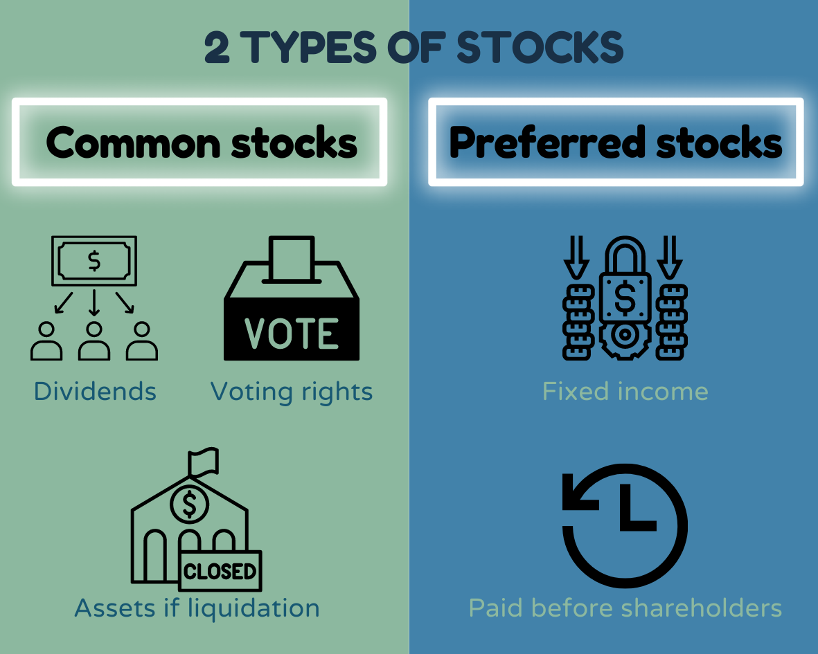
Types of Stocks
Common stocks: give ownership and voting rights.
Preferred stocks: pay fixed dividends but no voting rights.
Growth vs Value stocks:
  Growth = fast-growing companies, higher risk/reward.
  Value = stable companies trading below their worth.

Slide 5

Risk, Reward, and Time
Stocks can rise and fall in the short term — that’s volatility.
Over time, stocks historically outperform savings and bonds.
The key to success: invest for the long term, not quick wins.

Slide 6

First Steps
Open a brokerage or investing app account.
Start small — even $10 or fractional shares can build wealth.
Consider ETFs or index funds if you want simple diversification.
Stay consistent: regular investing beats trying to “time” the market.

Slide 7
Learning Assessment Question 1
What does owning a stock actually mean?
  You’re lending money to a company
  You own a small part (share) of that company
  You’re guaranteed a fixed return
  You’re an employee of the company

Slide 8
Question 2
Which of the following is one way investors can make money from stocks?
  Collecting capital gains when the stock price increases
  Paying dividends to the company
  Selling bonds at a discount
  Avoiding all market risk

Slide 9
Question 3
What is a key difference between growth and value stocks?
  Growth stocks are usually slower but safer
  Value stocks are overhyped and risky
  Growth stocks focus on expansion; value stocks are stable and often undervalued
  There is no difference — they’re the same

Slide 10
Question 4
Why is investing in stocks considered riskier in the short term?
  Because prices can fluctuate quickly
  Because stocks never go up
  Because they are illegal to trade daily
  Because they pay too many dividends

Slide 11
Question 5
What does a company gain by issuing stock to the public?
  Extra employees
  Money to fund and grow its business
  Guaranteed higher profits
  Less responsibility to shareholders

